Slide 1
Phase 2: Deep Traversal & The Recursive Mindset

Slide 2
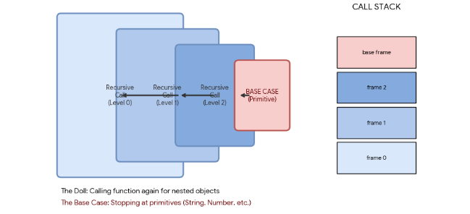
The Mental Model: "The Russian Matryoshka Doll"

Slide 3
Common Interview Pitfalls (The "Recursion Killers")
Pitfall | The "Red Flag" Detail | Engineering Impact / Solution
The null Collision | typeof null returns "object". | Crash Risk: Attempting to access keys of null throws a TypeError. Always check if (val === null) first.
The Array Paradox | typeof [] returns "object". | Structure Loss: Standard object iteration treats indices as string keys. Requires Array.isArray() to preserve order.
Context Loss | this binding disappears during traversal. | Logic Failure: Calling methods without .call(obj) points this to undefined (Lab R-16 fix).
Circular References | A "Remote" (Pointer) points back to a parent "House." | Infinite Loop: Recursion will never hit a base case, leading to a Stack Overflow crash.
const house = {};
house.itself = house; // The "Remote" points back to the "House"
deepClone(house); // ERROR: Infinite Loop!

Slide 4
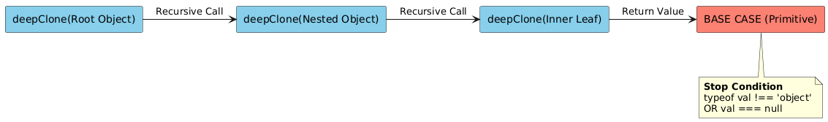
The Recursion Matryoshka: "The Exit Strategy"

Slide 5
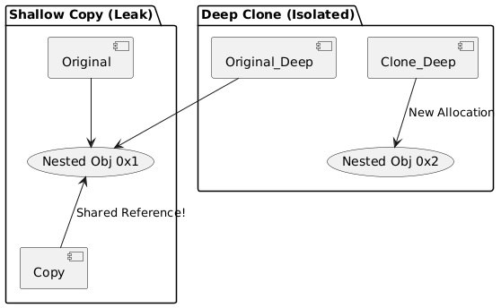
Shallow vs. Deep Clone: "Address Isolation"

Slide 6
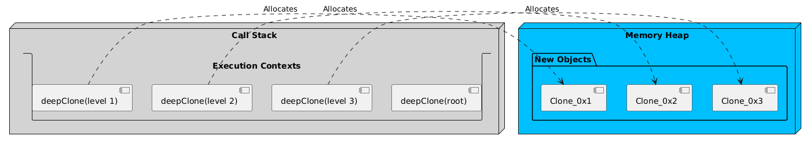
Recursive Call Stack vs. Heap Allocation

Slide 7
Code-Along (The Recursive Shadow Clone)
The Problem: Deeply duplicate an object so the clone and original are 100% isolated.
The Constraint: Reference Integrity: clone === original must be false. No "Remote" Leaks:
The Logic: "Open the doll" (Recurse) until you hit a primitive.

Slide 8
Context Control (The Solution)
Scenario | Code Execution | this Binding
Direct Call | asset.priceFn() | Points to asset (Works)
Extracted Call | const fn = asset.priceFn; fn() | Lost! Points to undefined
Restored Call | fn.call(asset) | Fixed: Manually points this back to asset
// During traversal, if we find a function:
if (typeof val === 'function') {
// Use .call(parentObj) to ensure 'this' is preserved
return val.call(parentObj);
}

Slide 9
Code-Along (Context Control)
The Problem: The Pricing Crash (Context Loss)
The Solution: The Pricing Extractor

Slide 10
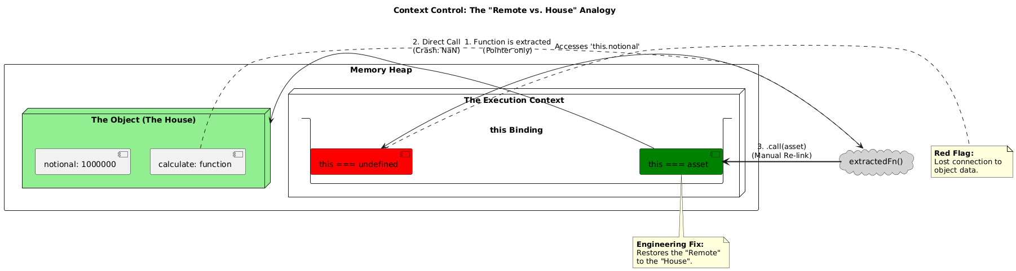
Context Control
Context Control

Slide 11
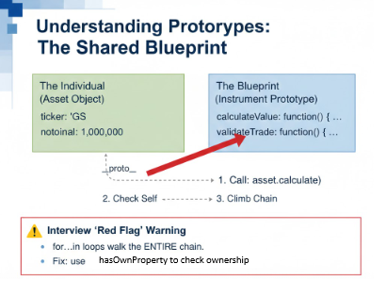

Slide 12
Lab R-05 (Prototype Bridge)
Level | Role | Analogous to... | Example Properties
Instrument | The Blueprint (Prototype) | The Superclass | calculateValue(), validate(), getRisk()
Asset | The Instance (Object) | The Subclass/Object | ticker: "GS", notional: 1000000, notionalCurrency: "USD"

Slide 13
The Engineering Architecture
Component | Role in Lab R-05 | Memory Impact
InstrumentPrototype | The "Superclass" holding shared pricing logic. | Low: One copy in the Heap.
buildBridge() | The logic that connects raw API data to the blueprint. | Efficient: No data is copied.
Object.setPrototypeOf | The mechanism that creates the inheritance chain. | Fast: Updates the hidden [[Prototype]] pointer.

Slide 14
Summary
Recursion over Iteration
Exit Early
Memory Isolation
Context Control

